Slide 1



College Football: The Decline of Defense
Is college football defense going the way of the dinosaur?
Team: Deinonychus aka TigerGatorNole
Karina Hutula
Michelle Davis
Darryl Connelly
Notes:
Michelle
Read slide..
Since we are all college football fans, our team decided to look into the state of college football. Intuitively, we all thought that scoring was happening more as the years have progressed. We wanted to know if the defensive side of the ball has declined statistically and where it has been impacted in the game.

Slide 2
Background
The NCAA is interested in how college football games are evolving over time to determine if changes are needed to increase its popularity. The NCAA wants to start by determining the direction of defense in college football and its effect on the game. We have been contracted to analyze the last 17 years of college football data to determine if the value of defense is diminishing.
Notes:
The reason we found this to be interesting is because we thought this data would be effective in possibly increasing the excitement and popularity of college football. This could useful in scheduling games to be shown on TV and growing TV ratings and viewings to name a few. To start, we looked at the overall view in scoring averages per season over the last 50 years then narrowed it down to more recent years.

Slide 3
Research Questions to Answer:
Have average points per game increased over time?
Have the total yards per game increased over time?
Are there more explosive plays?
Has 3rd down efficiency per game increased over time?
Have the number of turnovers per game decreased over time?
Are there less punts per game?
Notes:
These are the research questions we wanted to answer. The defense is responsible for stopping the offense from scoring which should cause a decrease or minor gain in points over time, creating turnovers by either lost fumbles or interceptions and lessening yards per game including more loss of yards by sacks or other tackles behind the yard of scrimmage. These metrics are directly impacted by defensive influence and with them we are able to interpret defensive value in college football.

Slide 4
Hypothesis
Defensive value may be decreasing as the years progress and may be less important to the success of a team
Notes:
The answers to the previous questions will either support or refute our hypothesis when all metrics are correlated or analyzed as a whole. Each question contributes to solving a piece of the puzzle when analyzing the value or effectiveness of defense in college football.

Slide 5
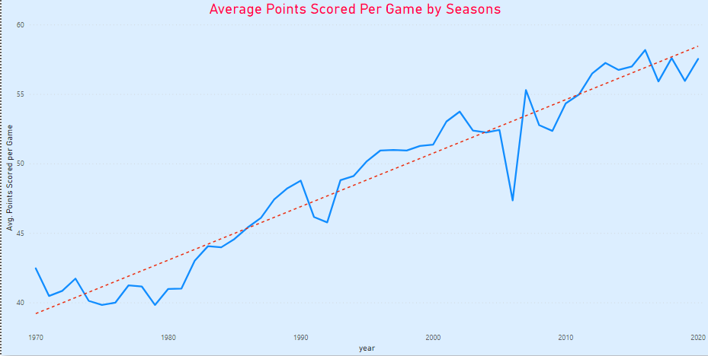
Scoring Since 1970
Notes:
We wanted to start by looking at the big picture. We began by looking at the average points scored per game by season at 1970 to look at scoring trends. The reasoning for starting at this timepoint is because some sources consider 1970 to be the beginning of the modern age of college football. As seen by the chart, you can perceive by the scoring trend there has been an exponential growth. With this in mind, does this mean that defensive statistics are trending down? Well let’s see…

Slide 6
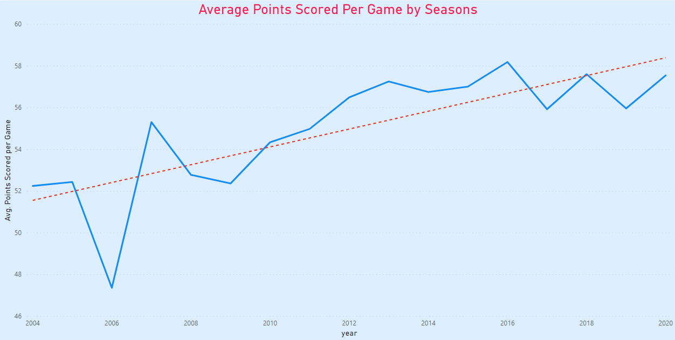
Narrowing the Focus
Correlation = 0.77
Notes:
We zoomed in from the previous graph to 2004 – now. Based on the NCAA request, a more recent time period would be better suited for our research. From here, we wanted to show all data points from the same time range for consistency.

Slide 7
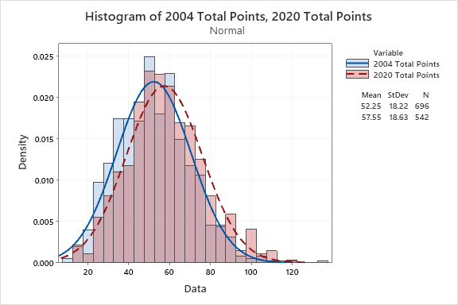
Reject the Null Hypothesis
2 sample T-test
P-value= 6.1526352641952e-07
Notes:
Darryl
Next, we were to compare the total point in 2004 to the total points in 2020. From our calculations, we have normal distribution using the two sample t-test and we showed there is a difference between 2004 and 2020. The p-value was low which allowed us to reject the null hypothesis that the means of points scored are the same. Thus proving the point that scoring in 2020 is higher than in 2004, supporting the previous charts shown.

Slide 8
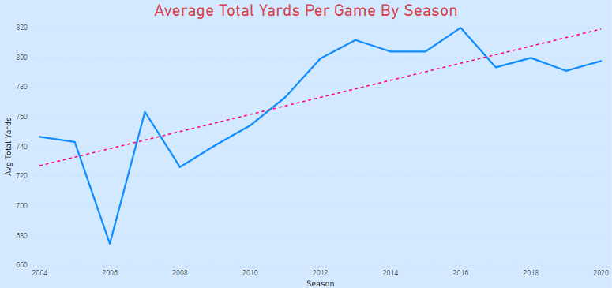
Total Yards Per Game
Correlation = 0.76
Notes:
As we looked into the total yards per game over the years, we also saw the numbers trending up with a strong correlation of 0.76 which is similar with total points per game. This metric is a relevant indicator of how well the offense did, so as a defense, you would want to limit the total yards the offense is able to accumulate. From the data, this again supports our hypothesis.

Slide 9
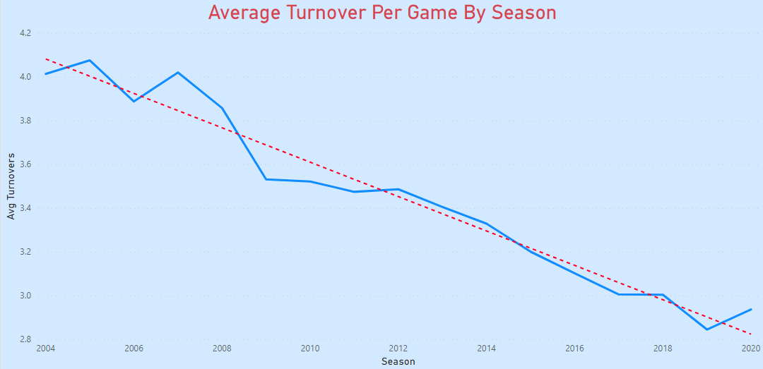
Pick-Six to the House...
Correlation = -0.98
Notes:
In American football, a turnovers happen when the defense takes the ball away from the offense. That is attributed to fumbles, interceptions and turnovers on downs by way of failed 4th down conversions. The number of turnovers is a positive defensive statistic. We can see the trend of turnovers are decreasing over time and dropping significantly. The correlation shows that this is the strongest evidence so far.

Slide 10
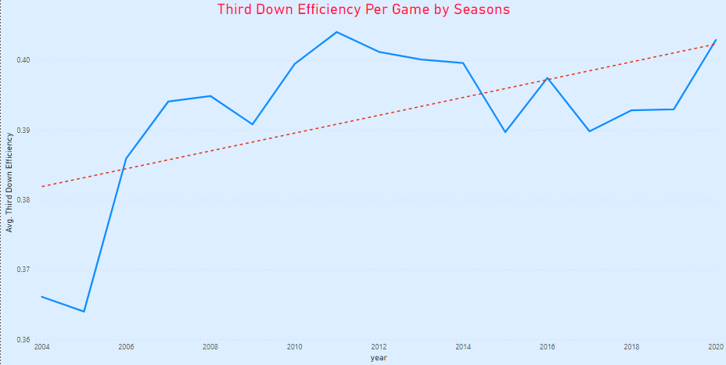
Get the Offense Off the Field
Correlation = 0.57
Notes:
As a defense, 3rd down is the money down; you must get the offense off the field. That is, the defense must not allow the offense to convert the 3rd down to a new set of downs by reaching the 1st down line. It’s often the most critical moment for the defense to get the ball back to their offense. Depending on field position, the vast majority of failed 3rd down conversions result in a punt or field goal attempt. Even though the correlation is moderate it still contributes to supporting our hypothesis.

Slide 11
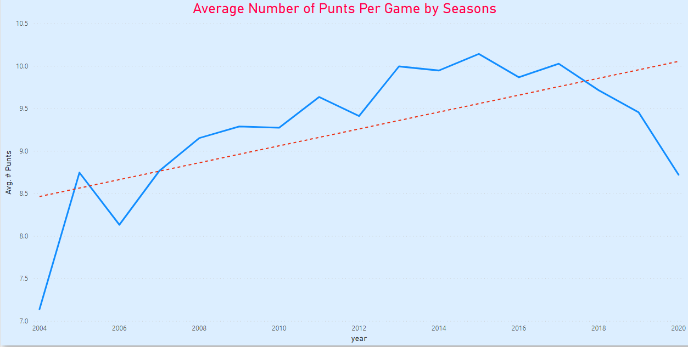
Punts
Correlation = 0.64
Notes:
We decided to look at punts as opposed to field goals because punts are generally attributed to field position without a time or points factor included. As with plays for loss, we believed we would see less punts over time because the offense would be scoring more often and being able to convert more 3rd downs. If so, this would be plus for the defense. This chart is showing that punts are trending upwards with a correlation of 0.64 which is also similar to the plays for loss correlation. This trend is also contrary to our hypothesis, but we believe this is a result of more possessions by the offense or increase games speed leading to more plays.

Slide 12
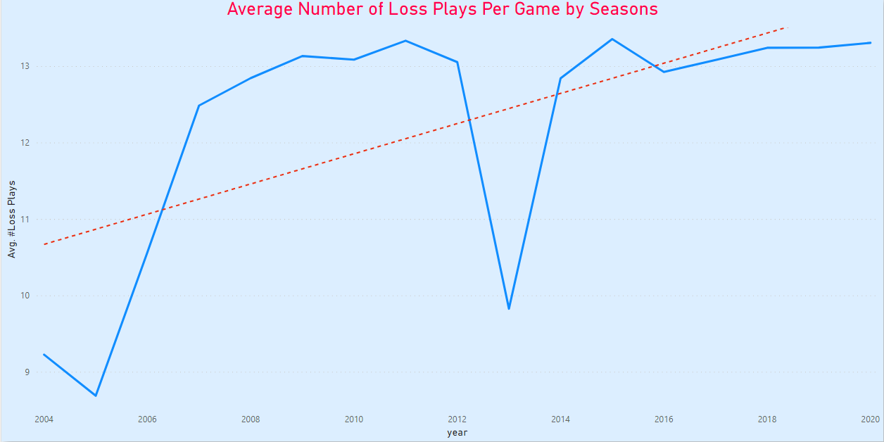
Plays for Loss
Correlation = 0.65
Notes:
Karina
Along with our thoughts on punts, we believed we would see less plays for loss over time because of the increase in offensive yards.
This chart, however, shows a moderately correlated, increasing trend over time.
Though this trend is contrary to our hypothesis, plays for loss could be a result of more possessions by the offense or an increase game speed, which leads to more plays overall.
Further analysis would be needed to investigate if the pace of play is changing and how it may be impacting the game.

Slide 13
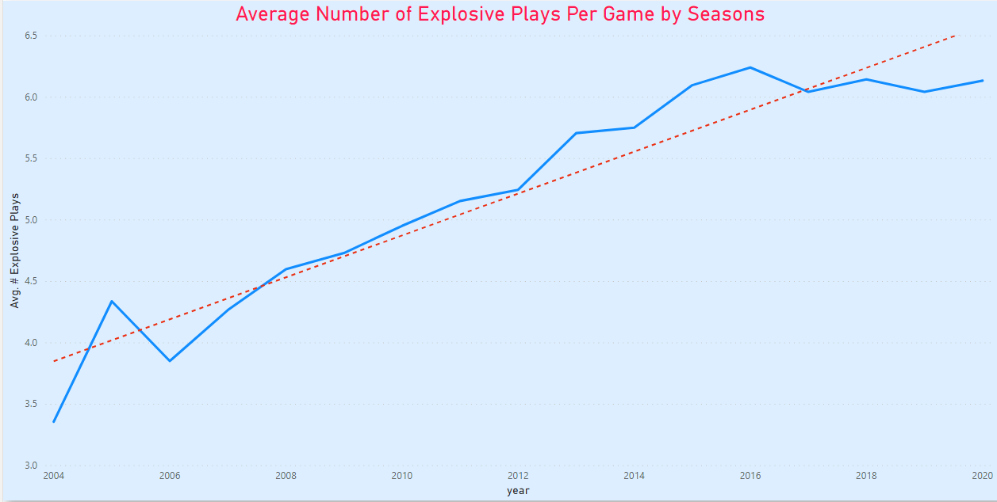
Are there More Explosive Plays?
Correlation = 0.95
Notes:
Another way to qualify defensive value is by looking at the number of offensive explosive plays per game.
We defined an explosive play as a running play that goes for 20 or more yards and a passing play that goes for 30 or more yards.
Our expectation was that explosive plays would be increasing over the years, and we’ve been proven correct with a strong, positive correlation of 0.95.

Slide 14
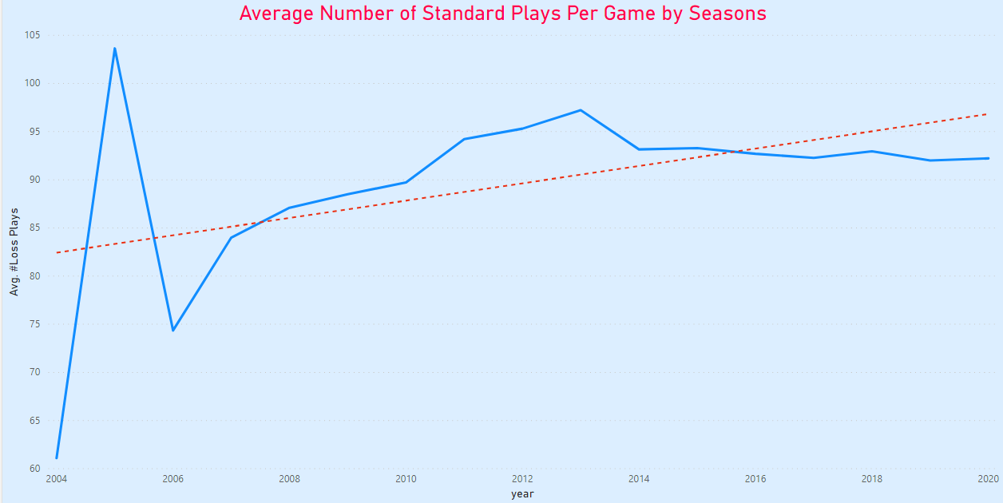
Total Standard Plays Per Game
Correlation = 0.48
Notes:
To take it one step further, we wanted to see how standard plays have changed over time.
Standard plays are defined as anything not categorized as a loss or explosive.
We would have expected to see a relatively flat line here, but we are again seeing a moderate increase.
Interestingly, all three play categories have increased over time. This is another piece of evidence to encourage future investigation into change of game pace.

Slide 15
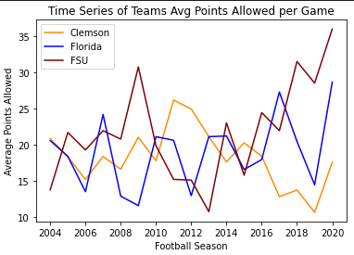
Defense Wins Championships
Notes:
From our previous data, we were able to conclude that the average defensive value has declined statistically over the years.
Even with our individual favorite teams, all being championship game winners within this time frame, we can see 2 of the 3 teams have declined defensively.
When we look at this data, we see that defense is still needed to be a championship contender even if the offensive stats are over-powering.
Florida:
2006 SEC Champs, BCS Champs
2008 SEC Champs, BCS Champs
2009 SEC East Champs, No 3 Final Ranking
FSU:
2013: ACC Champs, National Champs
Clemson:
2015: ACC Champs, National Champ Runner Up
2016: ACC Champs, National Champs
2017: ACC Champs, CFB Playoffs
2018: ACC Champs, National Champs
2019: ACC Champs, National Champ Runner Up

Slide 16
Conclusion
The data analyzed in our study strongly supports our hypothesis
Defensive value may be decreasing as the years progress
Implications
Assuming no changes are made to the game, we can continue to expect to see a rise in scoring as the seasons go on
The apparent value of defensive players may be harmed by this trend, though a high caliber defense may still be important to having a high achieving team
Recommendations
Investigate if the trend of defense has had or will have a negative impact on the game, such as competitiveness or excitement of the game
Investigate how the speed of gameplay has changed over time and its affects on offense and defense
Investigate the relationship between strength of defense and team performance

Slide 17
Limitations of Dataset
Prior to 2004, some statistics not available
Analysis does not account for rule changes which over time may be a causal factor
Did not account for point scored by defense
Does not include bowl games and playoffs
Did not segment by passing or running plays
Did not segment by fumbles for loss or interceptions
Explosive plays do not necessarily equate to 1st down conversions
Did not segment by teams and/or conferences
Notes:
For continuity of story, we wanted to present our limitations last.
To be transparent, there were a few limitations in our dataset when we went to pull our data.
One of the main reasons we looked at most of our data from 2004-2020 was because a lot of the data we originally wanted was not available in the years prior to 2004, so we were forced to narrow our scope of evaluation.
We did not account for any rule or gameplay changes; we went solely off of stats.
When using the data for points, we didn’t account for how the points were made including defensive scoring, special team scoring, safeties and field goals.
The dataset didn’t include playoffs and bowl games.
The total yards aren’t broken down into passing or running yards.
Our turnover data isn’t split into whether they were fumbles for loss or interceptions.
The explosive play data didn’t specify whether yards were lost before the explosive play happened within the same drive.
Lastly, we did not analyze the data by conference or individual team

Slide 18

Notes:
The End!

